Slide 1
05 Planning

Slide 2

This tutorial is mainly contributed by…
Github
方泽鸣，zemingfang11@gmail.com
张洳源，ruyuanzhang@gmail.com
张洁莹，jieying.zhang@student.uva.nl
部分内容由张洳源老师正在编写的教材《认知行为的计算原理》收录： https://ruyuanzhang.gitbook.io/compmodcogpsy

Slide 3
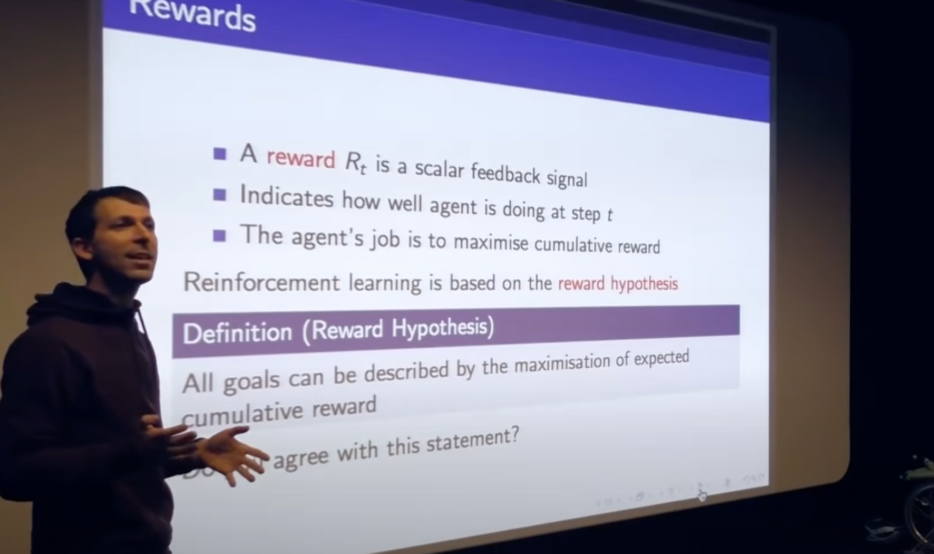
Goal: reward hypothesis

Slide 4
Definition:
Goal:
Model-based
Model-free
A lack of model
Dynamic Programming
Monte Carlo Method
Policy iteration
Value iteration
Online learning
Temporal Difference learning
Q learning
Sarsa
Continuous action spaces, stochastic policy
Policy Gradient Method
REINFORCE
Actor-critic

Slide 5
Definition:
Goal:
Model-based
Model-free
A lack of model
Dynamic Programming
Monte Carlo Method
Policy iteration
Value iteration
Online learning
Temporal Difference learning
Q learning
Sarsa
A state space, high uncertainty
Decision-Time Planning
Monte Carlos Tree Search
(MCTS)
Continuous action spaces, stochastic policy
Policy Gradient Method
REINFORCE
Actor-critic

Slide 6
Overview
Lecture
What is planning?
Monte Carlo Tree Search
Dynamic changing environment
Practice
MCTS

Slide 7
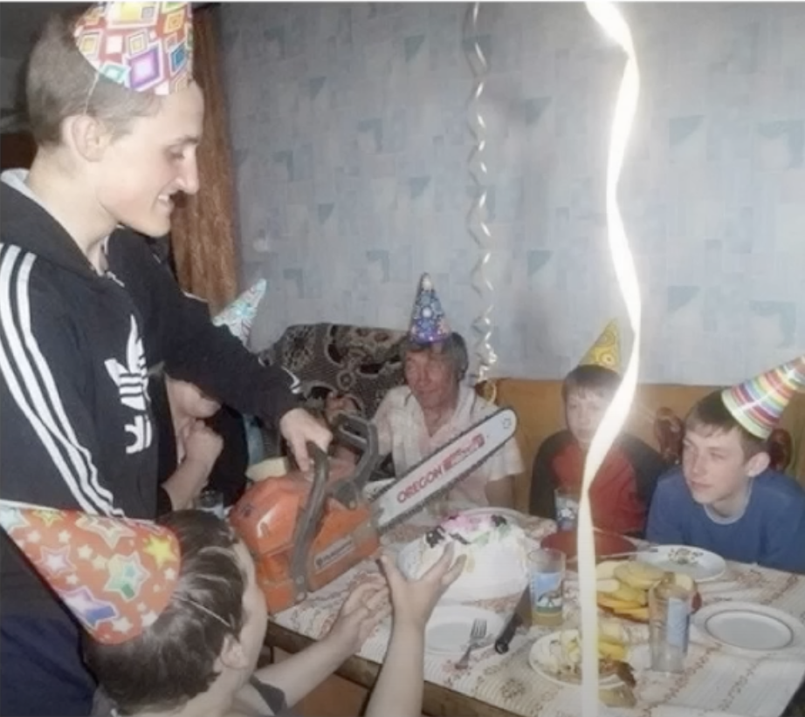
(McElearth 2023)

Slide 8
Overview
Lecture
What is planning?
Monte Carlo Tree Search
Dynamic changing environment
Practice
MCTS

Slide 9
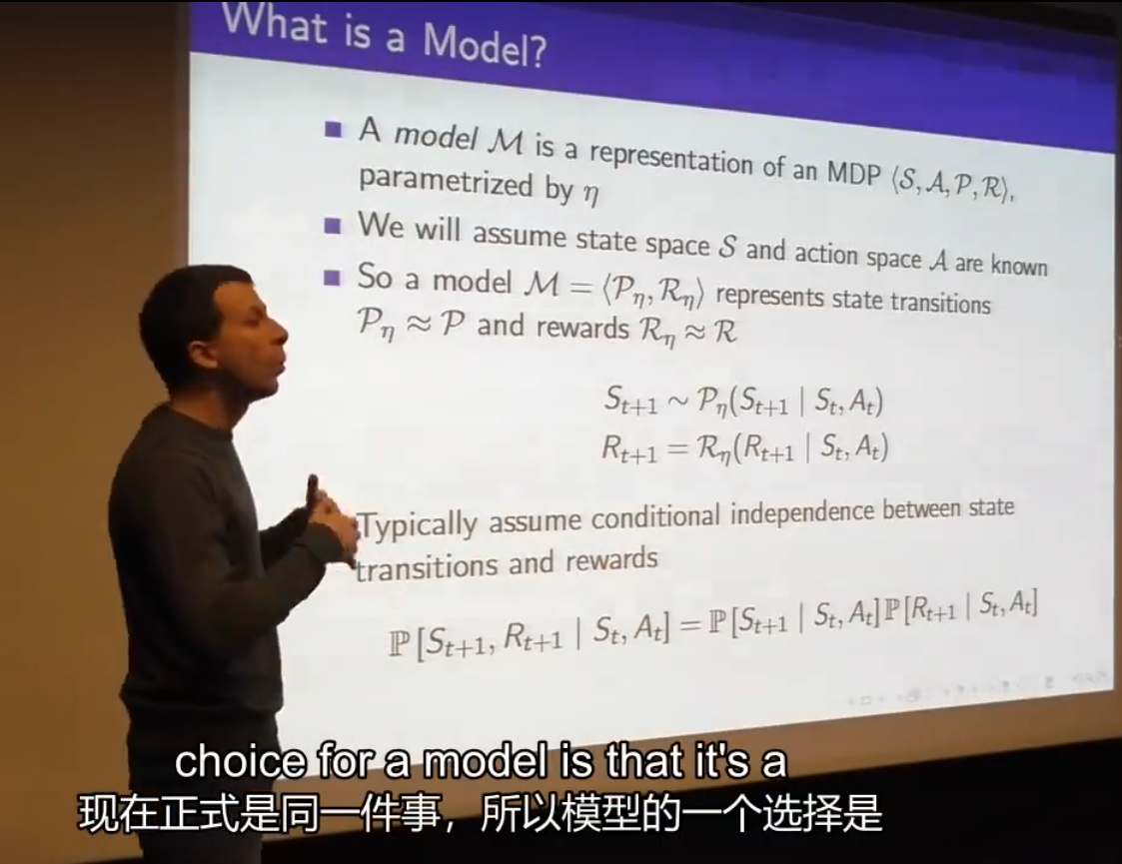
What is a model

Slide 10
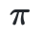

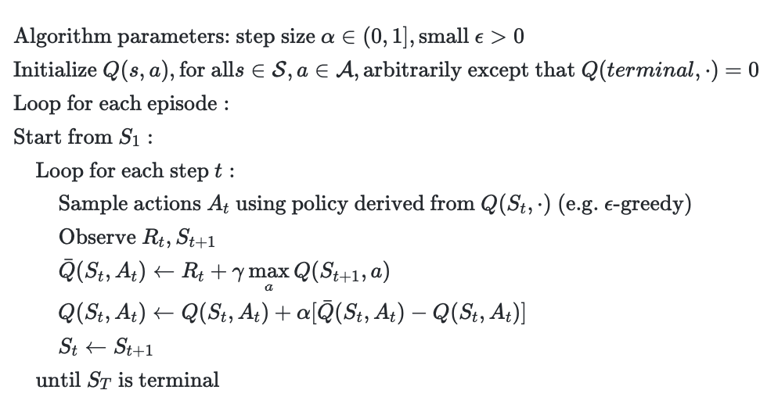

Model-free RL semantics
Agent
s
a
r
Environment

Slide 11

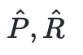
What if we know the models?
Agent
s
r
a
s
a
r
Environment

Slide 12
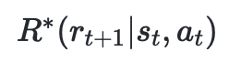
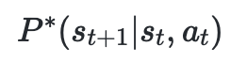
The semantic of learning
Reality

Slide 13
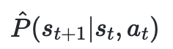
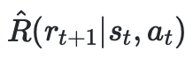
The semantic of planning
Reality
Imagination

Slide 14
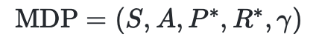
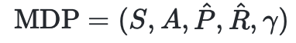
The definition of planning
Learning refers to the computational process that produces or improves a policy by gaining real-world experience through interaction with the environment.
Planning entails producing or improving a policy by utilizing simulated experiences derived from interactions with a modeled environment.

Slide 15

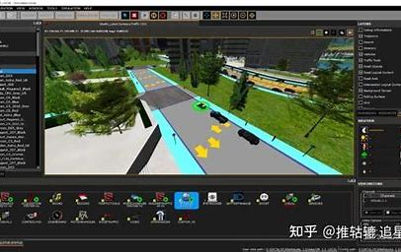
The benefit of planning

Slide 16
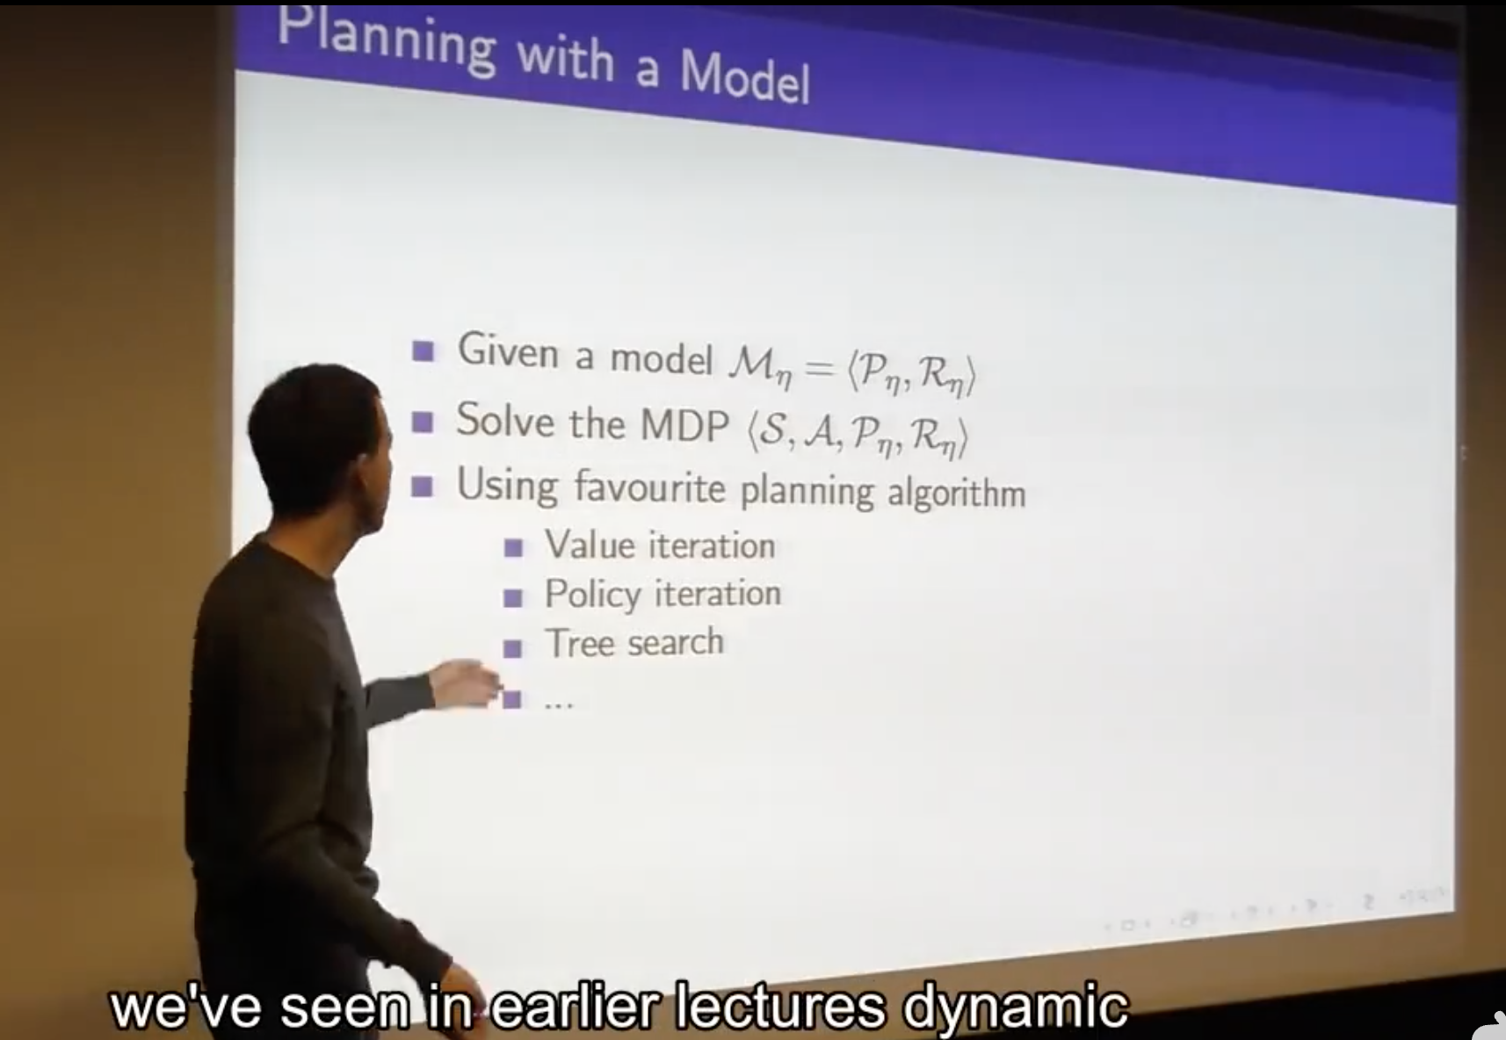

Slide 17
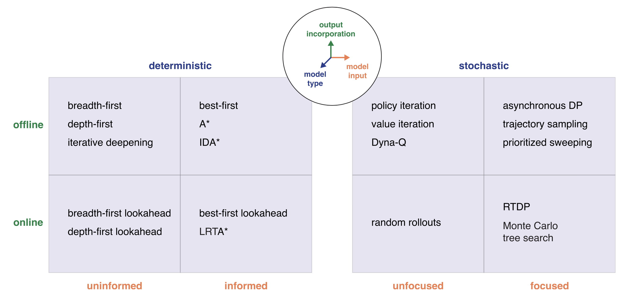
Planning and search algorithms
(Mattar & Lengyel, 2021)

Slide 18
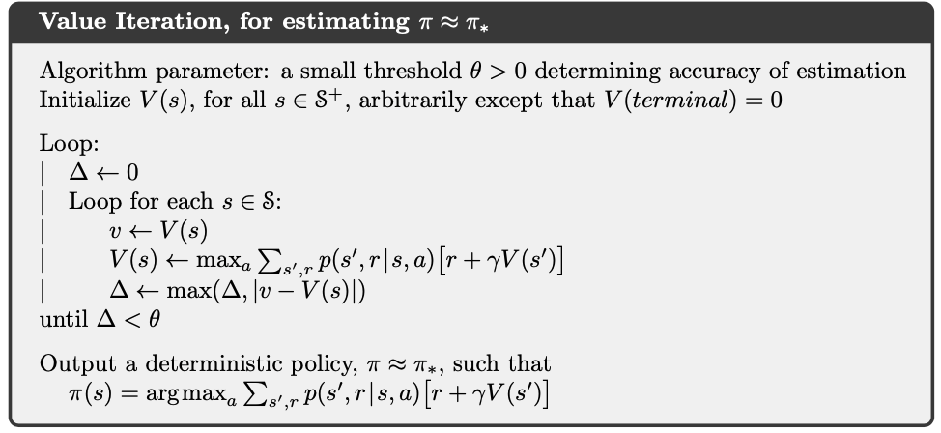
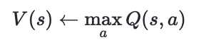
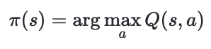
What’s wrong with Dynamic Programmings?

Slide 19
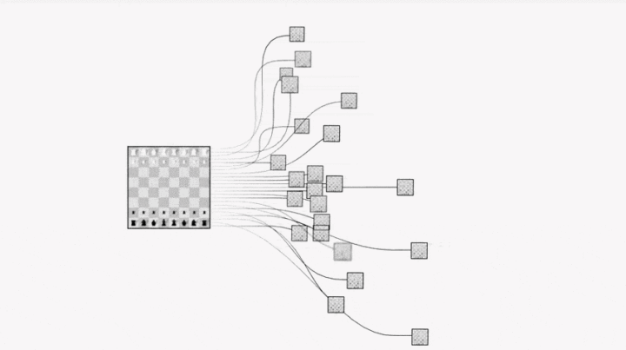

Slide 20
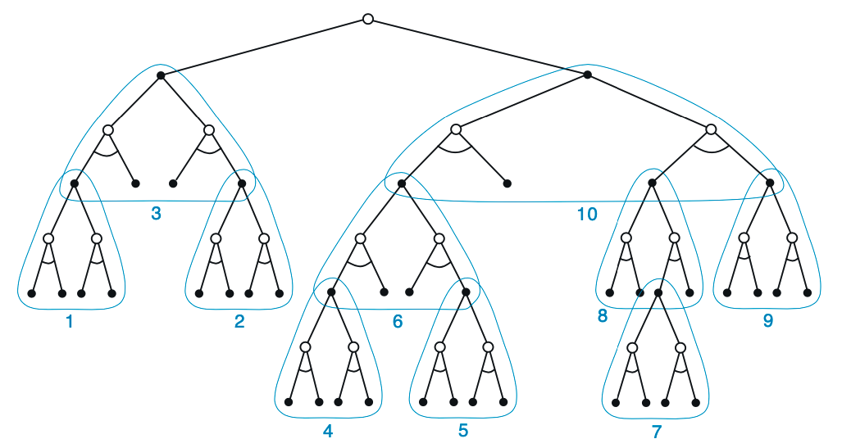
Tree search (Decision time forward search)
Root
For each state enounctered, a large tree of possible continuations is considered.
The apprxomiate value function is applied to the leaf nodes.
The value is backed up towards the root from leaves.
The backup stops at the state-action nodes for the current state.
Node
Parent
Child
Leave
How to approximate value without full tree?

Slide 21
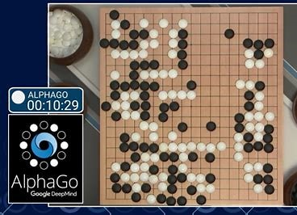

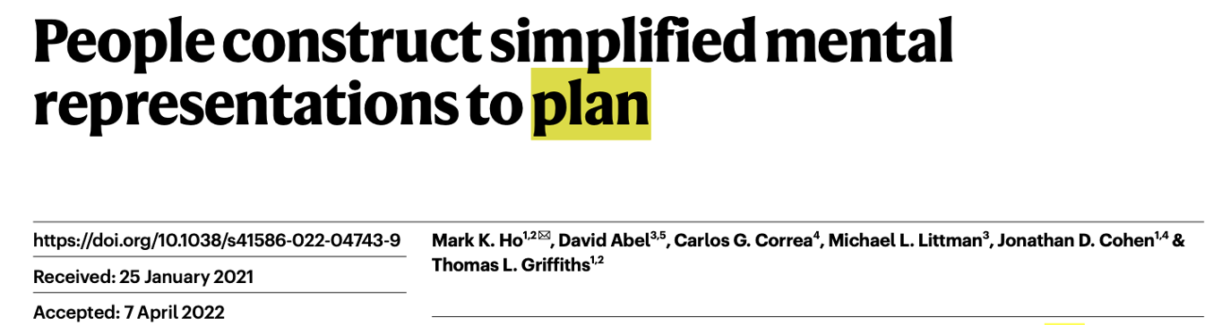
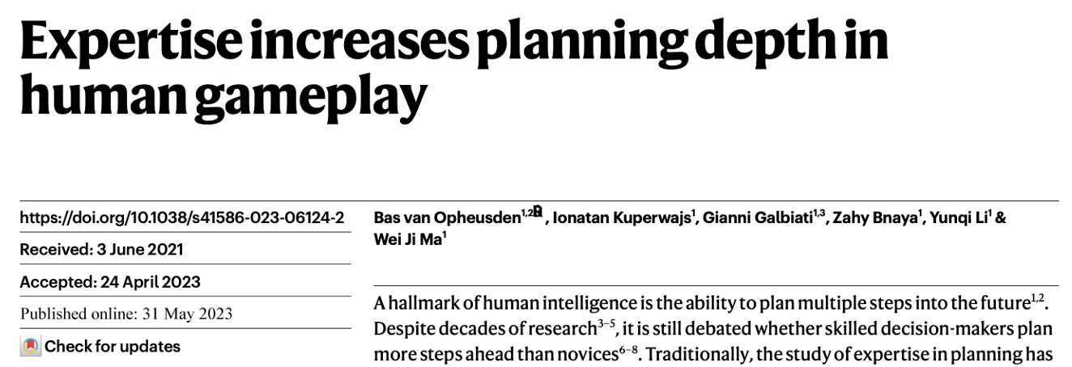
Monte Carlo Tree Search (MCTS)
1. The State-of-Art planning algorithm in AI
2. An Esstential benchmark model in human studies

Slide 22
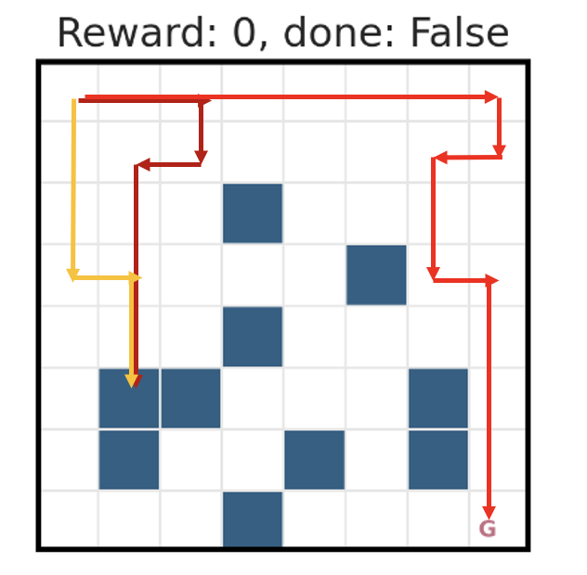

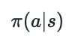
Rollout in MCTS
How to approximate value without full tree?
S_{t}
a=0
a=1
a=1
S_{t+1}
S_{t+1}
S_{t+1}
S_{t+2}
S_{t+2}
S_{t+2}
S_{t+2}
S_{t+2}
S_{t+2}
Rollout

Slide 23
Monte Carlo Tree Search (MCTS)
S_{t}
Select & expand
Rollout
Backpropagate

Slide 24
Monte Carlo Tree Search (MCTS)
S_{t}
a=0
Select & expand
S_{t+1}
Rollout
Backpropagate
R = -1

Slide 25
Monte Carlo Tree Search (MCTS)
S_{t}
a=0
Select & expand
S_{t+1}
Rollout
Backpropagate
R = -1

Slide 26
Monte Carlo Tree Search (MCTS)
V += -1
N += 1
S_{t}
V += -1
N += 1
a=0
Select & expand
V += -1
N += 1
S_{t+1}
Rollout
Backpropagate
R = -1

Slide 27
Monte Carlo Tree Search (MCTS)
S_{t}
a=0
a=1
Select & expand
S_{t+1}
S_{t+1}
Rollout
Backpropagate
R = -1
R = 1

Slide 28
Monte Carlo Tree Search (MCTS)
S_{t}
a=0
a=1
a=2
Select & expand
a=1
S_{t+1}
S_{t+1}
S_{t+1}
S_{t+1}
Rollout
Backpropagate
R = -1
R = 1
R = 1
R = 1

Slide 29
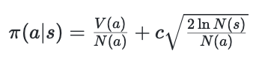
Monte Carlo Tree Search (MCTS)
V = 2
N = 8
S_{t}
a=0
a=1
a=2
Select & expand
a=1
V = -3
N = 2
V = 2
N = 4
V = -1
N = 1
V = 4
N = 10
S_{t+1}
S_{t+1}
S_{t+1}
S_{t+1}
Rollout
Choose the best action using UCT policy
Backpropagate

Slide 30
Monte Carlo Tree Search (MCTS)
S_{t}
a=0
a=1
a=3
Select & expand
a=2
S_{t+1}
S_{t+1}
S_{t+1}
S_{t+1}
Rollout
a=2
Backpropagate
S_{t+2}

Slide 31
Monte Carlo Tree Search (MCTS)
S_{t}
a=0
a=1
a=3
Select & expand
a=2
S_{t+1}
S_{t+1}
S_{t+1}
S_{t+1}
Rollout
a=2
Backpropagate
S_{t+2}
R = 1

Slide 32
Monte Carlo Tree Search (MCTS)
S_{t}
a=0
a=1
a=2
Select & expand
a=1
S_{t+1}
S_{t+1}
S_{t+1}
S_{t+1}
Rollout
a=2
Backpropagate
S_{t+2}
R = 1

Slide 33
#Practice: Monte Carlo Tree Search (MCTS)
S_{t}
a=0
a=1
a=2
Select & expand
a=1
S_{t+1}
S_{t+1}
S_{t+1}
S_{t+1}
Rollout
Backpropagate
R = -1
R = 1
R = 1
R = 1

Slide 34
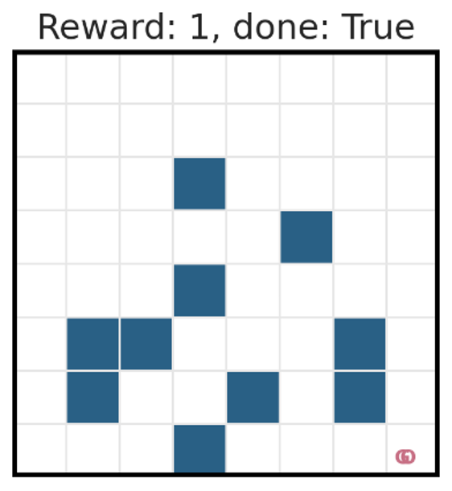
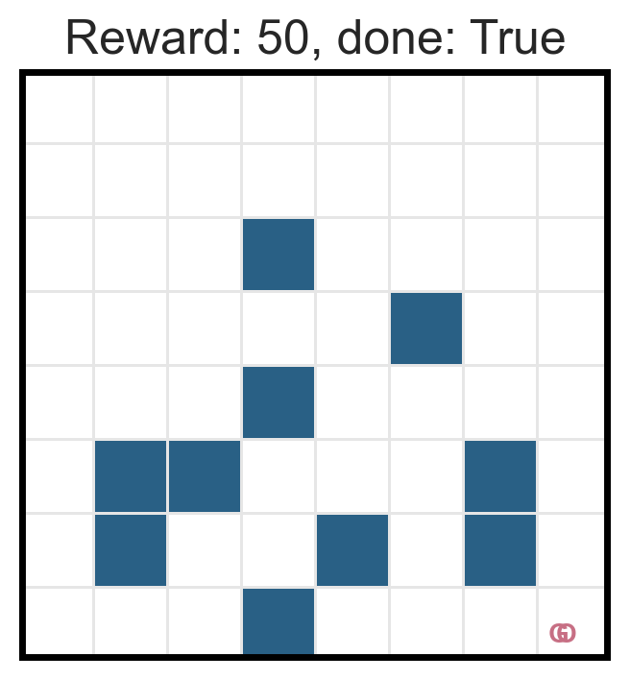
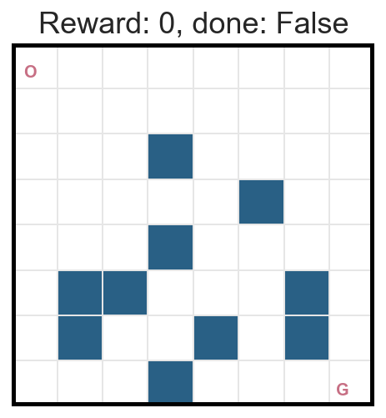
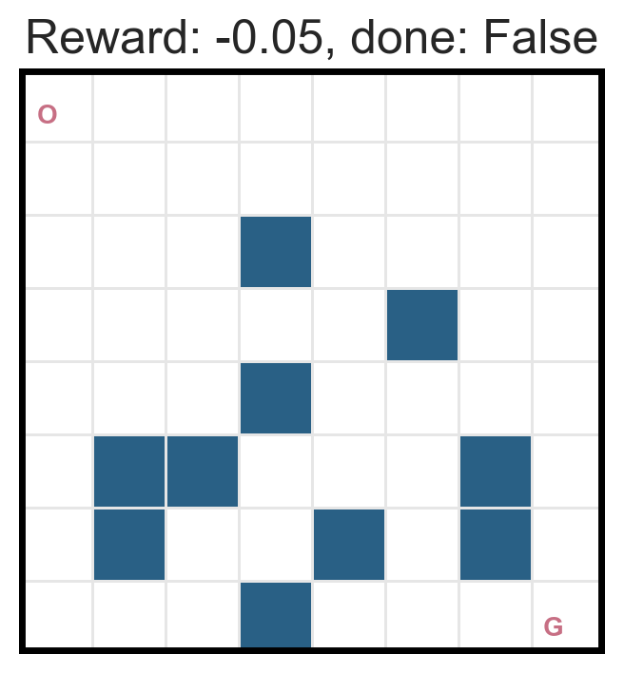
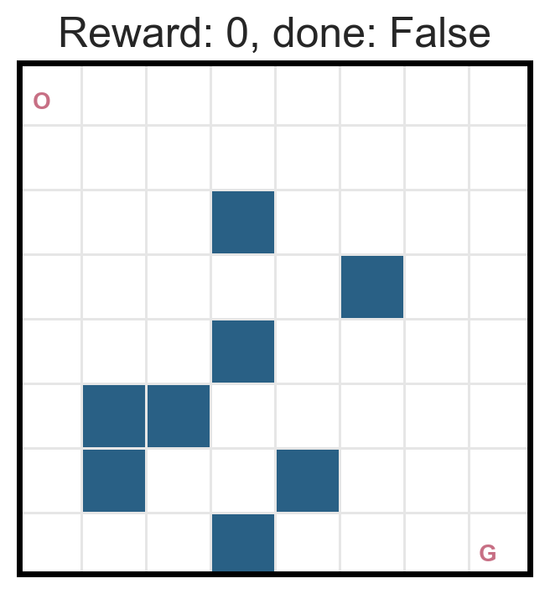
For better visualization
We need to make a few modifications…
1. Increased the reward
2. Add a simple penalty to ice sheet

Slide 35
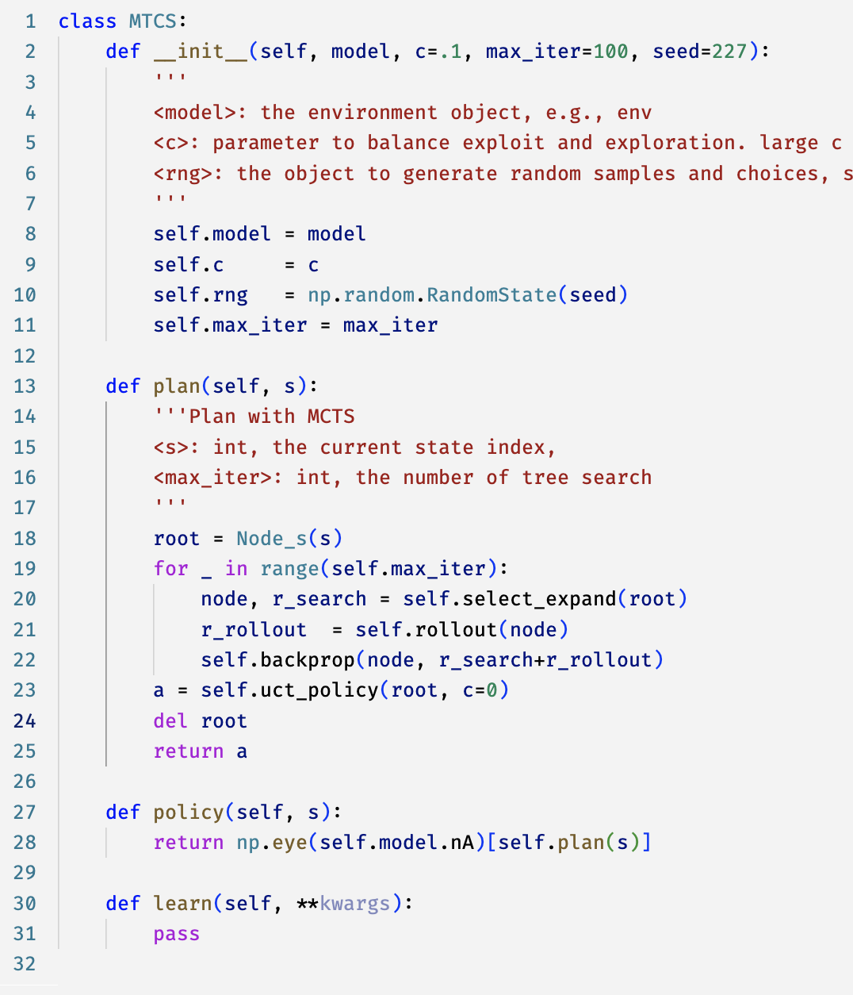
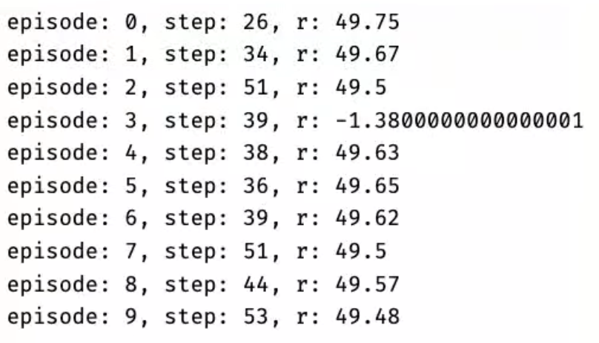
MCTS’s performance

Slide 36
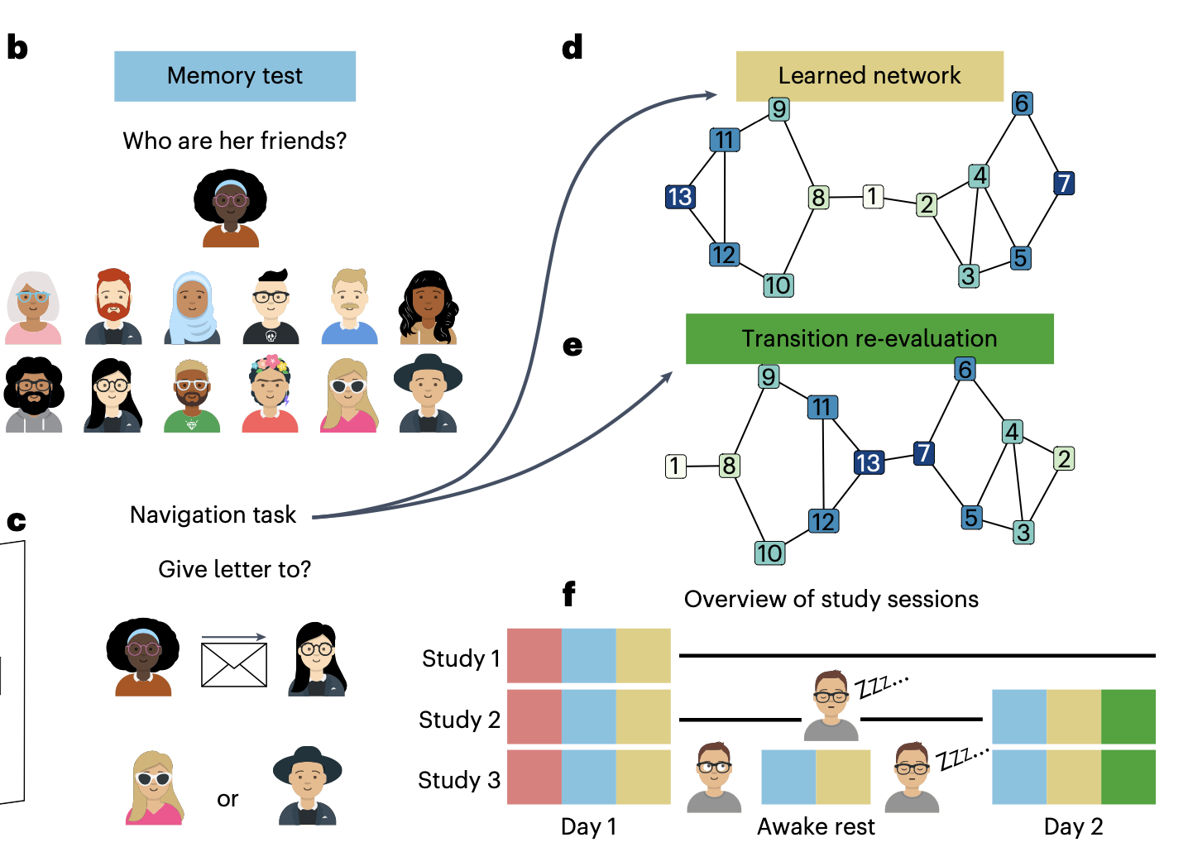
Changing environment
Why faster adaption is believed to use model-based and slower adapation is believed to use model-free?
(Son et al., 2024)

Slide 37
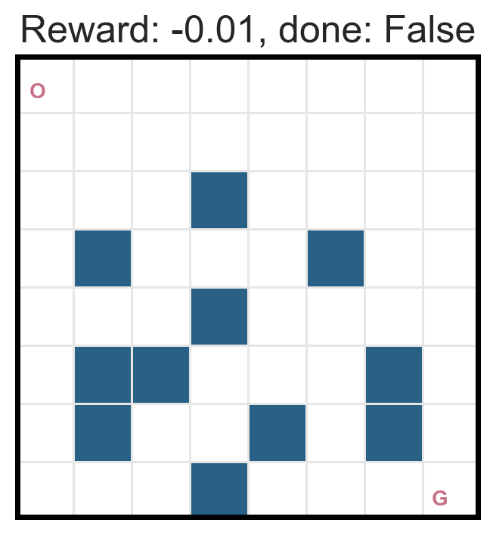
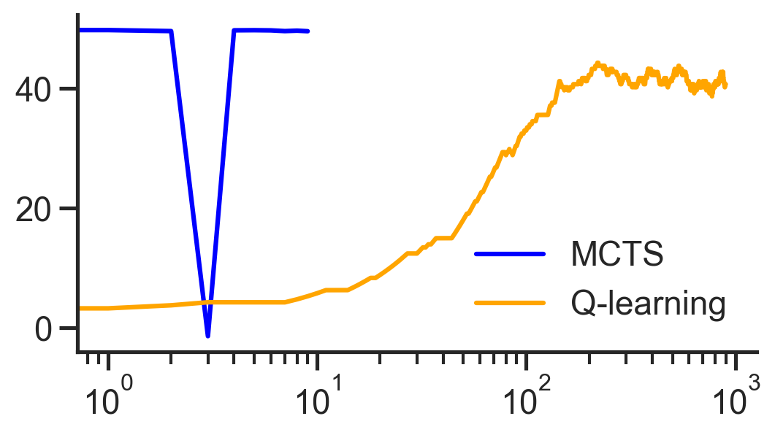

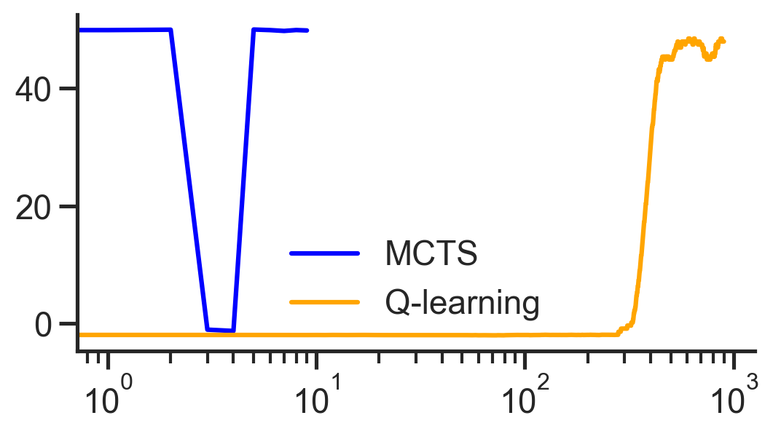
Model-based plan vs. model-free in chaning environment
Reward
Episode (log scale)
Reward

Slide 38
Definition:
Goal:
Model-based
Model-free
A lack of model
Dynamic Programming
Sampling and average
Monte Carlo Method
Policy iteration
Value iteration
Online learning
Use the current sample
Temporal Difference learning
Q learning
Sarsa
A state space, high uncertainty
Heuristic rollout
Decision-Time Planning
Monte Carlos Tree Search
(MCTS)
Continuous action spaces, stochastic policy
Gradient instead of greedy
Policy Gradient Method
REINFORCE
Actor-critic

